Slide 1


Water and Sewer Rate Study
June Lake Public Utility District
Robert D. Niehaus, Inc.
July 10, 2025

Slide 2
Background
  Rates last adjusted in FY 2022
  Significant capital expenditures are needed
    Sewer Plant equipment ranges from 30-60 years old
  Operating costs are projected to increase
  District should approve a reserve policy

Slide 3
Water Rates
Fixed Rates
Customer Class | Monthly Rate | Units | Fixed Revenue
Residential (per Unit) | $39.53 | 755 | $358,141.80
Commercial 3/4" | $39.53 | 0 | $0.00
Commercial 1" | $39.53 | 36 | $17,076.96
Commercial 1 1/2" | $79.06 | 17 | $16,128.24
Commercial 2" | $126.10 | 14 | $21,184.80
Commercial 3" | $235.43 | 1 | $2,825.16
Commercial 4" | $378.31 | 1 | $4,539.72
Commercial 6" | $436.15 | 1 | $5,233.80
Commercial 8" | $436.15 | 0 | $0.00
Flat Rate Residential | $43.29 | 10 | $5,194.80
Total Fixed Revenue |  |  | $430,325.28
Variable Rates
Customer Class | Rate per 1,000 gallons | Units | Variable Revenue
Residential
Tier 1 | $0.00 | 15,033 | $0.00
Tier 2 | $4.07 | 14,119 | $57,467.71
Commercial
Tier 1 | $2.52 | 28,528 | $71,891.49
Total Variable Revenue |  |  | $129,359.20
*Customer counts estimated based on billing records

Slide 4
Sewer Rates
Fixed Rates
Customer Class | Monthly Rate | Units | Fixed Revenue
Residential | $40.64 | 770 | $375,513.60
Automobile Service | $60.95 | 0 | $0.00
Car Washing Racks | $101.60 | 0 | $0.00
Automobile Service (restroom) | $30.48 | 0 | $0.00
Bakeries | $30.48 | 0 | $0.00
Barbershops | $30.48 | 0 | $0.00
Bars (per seat) | $2.03 | 291 | $7,088.76
Hotels (manager) | $40.64 | 0 | $0.00
per rental unit no kitchen | $11.15 | 1,477 | $197,671.17
per rental unit with kitchen | $15.17 | 25 | $4,551.00
Trailer Park (manager) | $40.64 | 0 | $0.00
per trailer | $16.21 | 0 | $0.00
Laundry machine | $60.95 | 0 | $0.00
Coin Operated Washer | $40.64 | 0 | $0.00
Professional Offices | $30.48 | 46 | $16,824.96
Public Showers | $10.21 | 0 | $0.00
Retail Stores | $30.48 | 0 | $0.00
Retail Stores (produce) | $60.95 | 0 | $0.00
Campground (per space) | $7.78 | 197 | $18,391.92
Picnic (per parking) | $0.87 | 0 | $0.00
Church | $30.48 | 0 | $0.00
Hospital Bed | $10.16 | 0 | $0.00
Hospital Kitchen | $30.48 | 0 | $0.00
Hospital Laundry | $60.95 | 0 | $0.00
Lodge | $30.48 | 0 | $0.00
School (per student) | $0.80 | 125 | $1,200.00
Total Fixed Revenue |  |  | $621,241.41
*Customer counts estimated based on billing records

Slide 5
Other Revenue
Water | FY 2025 | FY 2026 | FY 2027 | FY 2028 | FY 2029 | FY 2030 | FY 2031 | FY 2032 | FY 2033 | FY 2034
Other Operating Revenue | $10,120 | $10,120 | $10,120 | $10,120 | $10,120 | $10,120 | $10,120 | $10,120 | $10,120 | $10,120
Water Sales Other | $259 | $259 | $259 | $259 | $259 | $259 | $259 | $259 | $259 | $259
Other Service Charges | $3,720 | $3,720 | $3,720 | $3,720 | $3,720 | $3,720 | $3,720 | $3,720 | $3,720 | $3,720
Returned Check Fee | $0 | $0 | $0 | $0 | $0 | $0 | $0 | $0 | $0 | $0
Inspection Fee | $449 | $449 | $449 | $449 | $449 | $449 | $449 | $449 | $449 | $449
Tapping Fee | $3,598 | $3,598 | $3,598 | $3,598 | $3,598 | $3,598 | $3,598 | $3,598 | $3,598 | $3,598
Reconnetion Fee | $0 | $0 | $0 | $0 | $0 | $0 | $0 | $0 | $0 | $0
Fixture Costs | $2,094 | $2,094 | $2,094 | $2,094 | $2,094 | $2,094 | $2,094 | $2,094 | $2,094 | $2,094
Non-Operating Revenue | $517,167 | $525,302 | $533,598 | $542,060 | $550,691 | $559,494 | $568,472 | $577,628 | $586,968 | $596,493
Taxes | $404,946 | $413,045 | $421,306 | $429,732 | $438,327 | $447,093 | $456,035 | $465,156 | $474,459 | $483,948
Interest | $1,014 | $1,014 | $1,014 | $1,014 | $1,014 | $1,014 | $1,014 | $1,014 | $1,014 | $1,014
Connection Fees | $31,361 | $31,397 | $31,432 | $31,468 | $31,504 | $31,540 | $31,576 | $31,612 | $31,649 | $31,685
Miscellaneous Non-Operating Revenues | $79,846 | $79,846 | $79,846 | $79,846 | $79,846 | $79,846 | $79,846 | $79,846 | $79,846 | $79,846
Sewer | FY 2025 | FY 2026 | FY 2027 | FY 2028 | FY 2029 | FY 2030 | FY 2031 | FY 2032 | FY 2033 | FY 2034
Other Operating Revenue | $42,709 | $42,709 | $42,709 | $42,709 | $42,709 | $42,709 | $42,709 | $42,709 | $42,709 | $42,709
Returned Check Fee | $0 | $0 | $0 | $0 | $0 | $0 | $0 | $0 | $0 | $0
Inspection Fee | $441 | $441 | $441 | $441 | $441 | $441 | $441 | $441 | $441 | $441
Connection Fee | $31,343 | $31,343 | $31,343 | $31,343 | $31,343 | $31,343 | $31,343 | $31,343 | $31,343 | $31,343
Tapping Fee | $1,783 | $1,783 | $1,783 | $1,783 | $1,783 | $1,783 | $1,783 | $1,783 | $1,783 | $1,783
Miscellaenous Revenue | $9,142 | $9,142 | $9,142 | $9,142 | $9,142 | $9,142 | $9,142 | $9,142 | $9,142 | $9,142
Non-Operating Revenue | $429,723 | $438,055 | $446,554 | $455,223 | $464,065 | $473,084 | $482,283 | $491,667 | $501,238 | $511,000
Property Tax | $404,946 | $413,045 | $421,306 | $429,732 | $438,327 | $447,093 | $456,035 | $465,156 | $474,459 | $483,948
Interest | $1,014 | $1,014 | $1,014 | $1,014 | $1,014 | $1,014 | $1,014 | $1,014 | $1,014 | $1,014
Cell Tower Lease | $12,100 | $12,100 | $12,100 | $12,100 | $12,100 | $12,100 | $12,100 | $12,100 | $12,100 | $12,100
Local Benefit #1 | $11,663 | $11,896 | $12,134 | $12,377 | $12,624 | $12,877 | $13,134 | $13,397 | $13,665 | $13,938

Slide 6
Operating Expenses
Water | FY 2025 | FY 2026 | FY 2027 | FY 2028 | FY 2029 | FY 2030 | FY 2031 | FY 2032 | FY 2033 | FY 2034
Total | $841,855 | $879,216 | $918,132 | $955,089 | $993,347 | $1,030,280 | $1,068,701 | $1,108,675 | $1,150,269 | $1,193,554
Sewer | FY 2025 | FY 2026 | FY 2027 | FY 2028 | FY 2029 | FY 2030 | FY 2031 | FY 2032 | FY 2033 | FY 2034
Total | $1,085,173 | $1,133,322 | $1,183,419 | $1,230,163 | $1,278,408 | $1,324,301 | $1,371,986 | $1,421,539 | $1,473,040 | $1,526,570

Slide 7
Capital Expenses
Project | System | FY 2025 | FY 2026 | FY 2027 | FY 2028 | FY 2029 | FY 2030 | FY 2031 | FY 2032 | FY 2033 | FY 2034
Sewer Slip Line Project | SEWER |  |  |  |  |  | $162,370 | $150,000 | $150,000
Main Station 1 rehab | SEWER
Main Station 2 rehab | SEWER
Oh Ridge Lift Station Project | SEWER
SCADA System Upgrades | SEWER |  | $16,000 |  |  | $75,000
WasteWater Treatment Plant Rehab | SEWER |  |  |  |  |  | $200,000 | $300,000 | $400,000 | $300,000 | $1,000,000
Vactor Truck Replacement | SEWER | $446,653
Silver Lake LIFT ST Replacements | SEWER |  |  | $130,000 | $130,000 | $130,000 | $130,000 | $130,000 | $130,000
Camera Truck | SEWER
Trailered Trash Pump 6" | SEWER |  |  |  | $120,000
Field Vehicle Replacement Prgm | Sewer |  |  |  |  | $32,500 |  | $35,000 | $35,000
GIS Mapping Project | WAT/SEW |  |  |  | $10,000
Generator Project (Grant funded) | WAT/SEW
Mini Excavator | WAT/SEW
Backhoe at WWTP | WAT/SEW
June Lake Plant upgrades | WATER
SCADA System Upgrades | WATER | $0 | $8,000 |  | $8,000 | $75,000
Turbidimeters/sensors | WATER | $6,523 | $30,000 | $8,000 | $5,000
Fitration Media Replacement | WATER
Water Tank Refinish Clark | WATER |  |  | $16,000 | $25,000
Water Tank Refinish Snow Creek | WATER |  |  | $16,000 | $25,000
Well Project - Village | WATER
Well Project - Down Canyon | WATER
Field Vehicle Replacement Prgm | Water |  |  |  |  | $32,500 |  | $35,000 | $35,000
Meter Replacement Prgm | WATER | $33,419 | $60,000 | $15,000 | $15,000 | $15,000
Diversion upgrades | WATER |  | $150,000
Replump Upper Clark water lines | WATER |  | $40,000
Water Main Replacement Campground | WATER |  |  | $350,000
Total Water |  | $39,942 | $288,000 | $405,000 | $83,000 | $122,500 | $0 | $35,000 | $35,000 | $0 | $0
Total Sewer |  | $446,653 | $16,000 | $130,000 | $255,000 | $237,500 | $492,370 | $615,000 | $715,000 | $300,000 | $1,000,000

Slide 8

Water Financial Plan

Slide 9
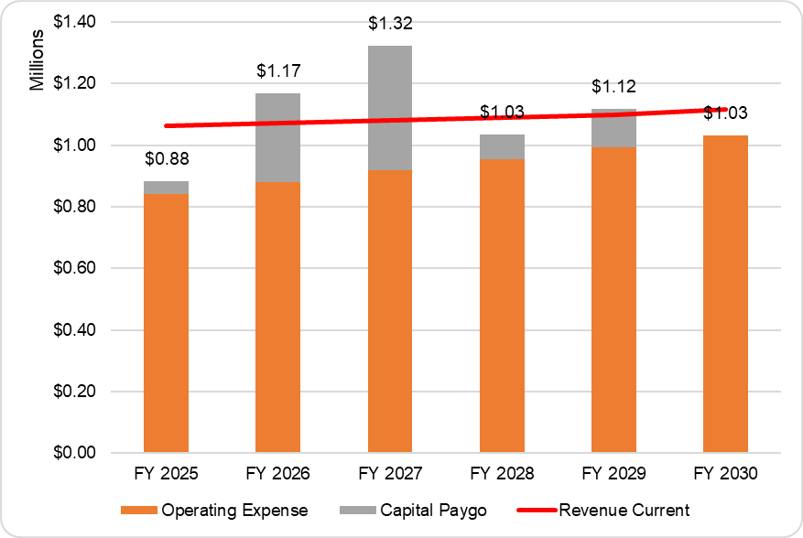
Water Financial Plan (Status Quo)

Slide 10
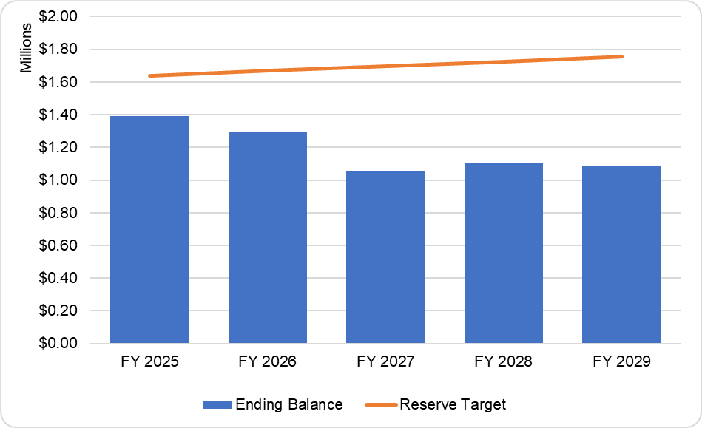
Water Fund Balances (Status Quo)
Reserve Policy:
Operating Reserve – 6 months operating
Emergency Reserve – 3 months operating
Capital Reserve – Total 10-years of planned CIP

Slide 11
Water Financial Plan (Proposed)
Revenue adjustments of 4% a year are needed to maintain fund balances and meet financial goals
RDN recommends that the District update rates to reflect the additional needed revenue

Slide 12
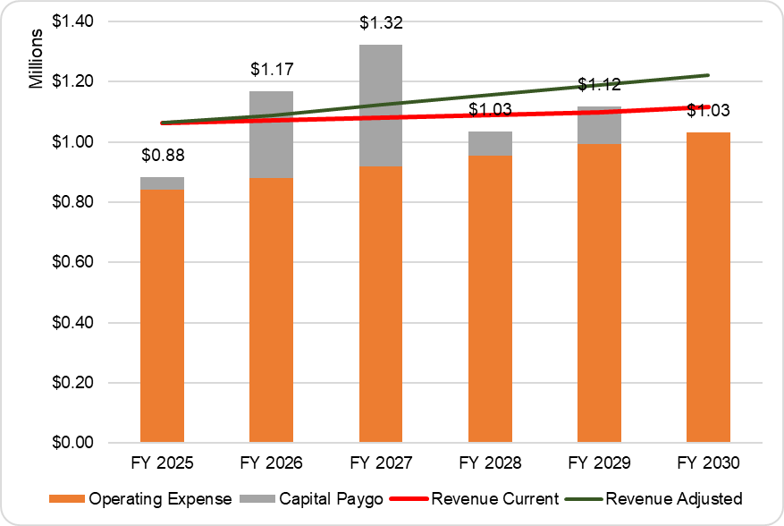
Water Financial Plan (Proposed)

Slide 13
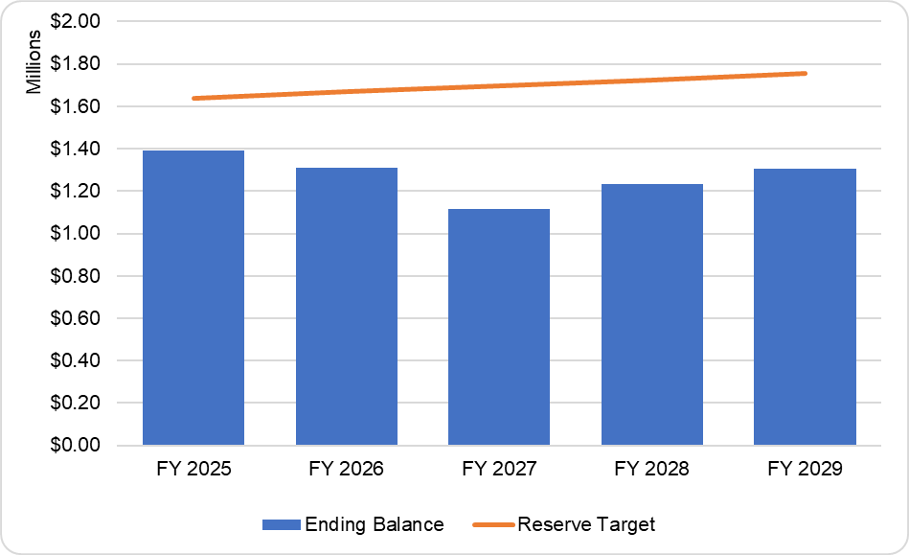
Sewer Fund Balance (Proposed)
Reserve Policy:
Operating Reserve – 6 months operating
Emergency Reserve – 3 months operating
Capital Reserve – Total 10-years of planned CIP

Slide 14

Water Cost of Service/Rate Design

Slide 15
Water Cost of Service
Category | Cost Allocation
Operating Expenses | $841,855
Non-Operating Expenses | $39,942
Total Expense | $881,797
Other Operating Revenues | ($10,120)
Non-Operating Revenues | ($517,167)
Net Balance Adjustment | $181,930
Rate Revenue Requirement | $536,441
Meter Size | Meter Ratio
5/8" | 1.00
3/4" | 1.00
1" | 1.00
1 1/2" | 2.00
2" | 3.20
3" | 7.00
4" | 12.60
6" | 26.00
8" | 56.00
Water Use | FY 2025
Tota Metered Water Use (Tgal) | 57,681

Slide 16
Water Cost of Service
Cost Category | Cost of Service | Source of Supply | Base | Meters | Customer Service
O&M Revenue Requirements | $841,855 | $141,342 | $590,726 | $54,894 | $54,894
Non-Operating Revenue Requirements | $39,942 | $17,425 | $15,941 | $6,576 | $0
Total | $881,797 | $158,767 | $606,666 | $61,470 | $54,894
Percent of Total |  | 18% | 69% | 7% | 6%
Other Operating Revenue | ($10,120) | ($1,822) | ($6,962) | ($705) | ($630)
Non-Operating Revenue | ($517,167) | ($93,116) | ($355,805) | ($36,052) | ($32,195)
Net Balance From Operations | $181,930 | $32,756 | $125,166 | $12,682 | $11,326
Rate Revenue Requirement | $536,441 | $96,586 | $369,065 | $37,395 | $33,395

Slide 17
Water Rate Design Recommendations
Bill for all water use
Bill all customers the same fixed and variable charges

Slide 18
Water Rate Design (Fixed)
Meters |  | Units |  | Annual Cost |  | Bills |  | Monthly Cost
$37,395 | / | 925.4 | = | $40.41 | / | 12 | = | $3.37
Base |  | Units |  | Annual Cost |  | Bills |  | Monthly Cost
$295,252 | / | 925.4 | = | $319.05 | / | 12 | = | $26.59
Customer Service |  | Units |  | Annual Cost |  | Bills |  | Monthly Cost
$33,395 | / | 835 | = | $39.99 | / | 12 | = | $3.33
Meter Size | Meter/Base |  | Meter Ratio |  | Monthly Meter |  | Customer Service |  | COS Rate
5/8" | $29.96 | x | 1.00 | = | $29.96 | + | $3.33 | = | $33.29
3/4" | $29.96 | x | 1.00 | = | $29.96 | + | $3.33 | = | $33.29
1" | $29.96 | x | 1.00 | = | $29.96 | + | $3.33 | = | $33.29
1 1/2" | $29.96 | x | 2.00 | = | $59.91 | + | $3.33 | = | $63.24
2" | $29.96 | x | 3.20 | = | $95.86 | + | $3.33 | = | $99.19
3" | $29.96 | x | 7.00 | = | $209.69 | + | $3.33 | = | $213.02
4" | $29.96 | x | 12.60 | = | $377.44 | + | $3.33 | = | $380.77
6" | $29.96 | x | 26.00 | = | $778.84 | + | $3.33 | = | $782.17
8" | $29.96 | x | 56.00 | = | $1,677.49 | + | $3.33 | = | $1,680.83

Slide 19
Water Rate Design (Variable)
Base |  | Source of Supply |  | Water Use |  | Per 1,000 gallons
$73,813 | + | $96,586 | / | 57,681 | = | $2.95

Slide 20
Water Rate Design (Unmetered)
Fixed |  | Variable |  | Average Use (Tgal) |  | Residential Flat Rate
$33.29 | + | $2.95 | x | 3.2 | = | $42.79

Slide 21
Water Rate Design 5-Year Schedule
 | 4% | 4% | 4% | 4% | 4%
Meter Size | FY 2026 | FY 2027 | FY 2028 | FY 2029 | FY 2030
5/8" | $34.62 | $36.00 | $37.44 | $38.94 | $40.50
3/4" | $34.62 | $36.00 | $37.44 | $38.94 | $40.50
1" | $34.62 | $36.00 | $37.44 | $38.94 | $40.50
1 1/2" | $65.77 | $68.40 | $71.14 | $73.99 | $76.95
2" | $103.16 | $107.28 | $111.57 | $116.04 | $120.68
3" | $221.54 | $230.40 | $239.62 | $249.20 | $259.17
4" | $396.00 | $411.84 | $428.31 | $445.45 | $463.26
6" | $813.46 | $845.99 | $879.83 | $915.03 | $951.63
8" | $1,748.06 | $1,817.98 | $1,890.70 | $1,966.33 | $2,044.98
Unmetered | $44.51 | $46.29 | $48.14 | $50.06 | $52.07
Variable Rate | $3.07 | $3.20 | $3.32 | $3.46 | $3.59

Slide 22
Sewer Financial Plan

Slide 23
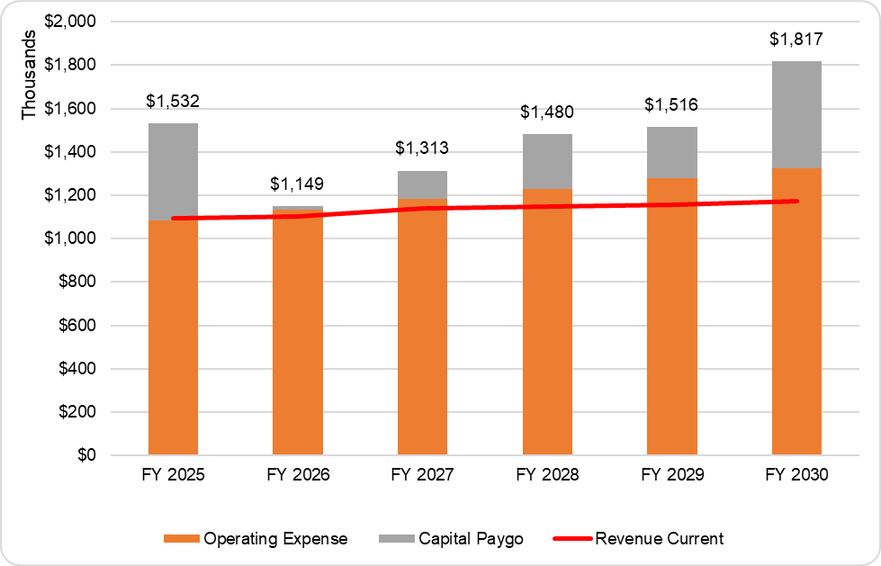
Sewer Financial Plan (Status Quo)

Slide 24
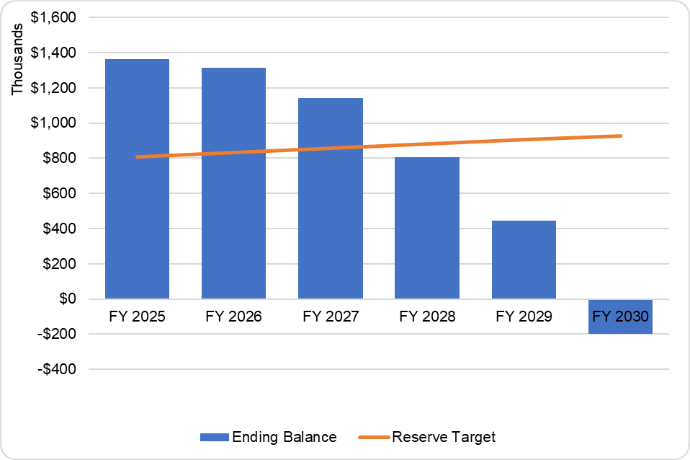
Sewer Fund Balances (Status Quo)
Reserve Policy:
Operating Reserve – 3 months operating
Emergency Reserve – 3 months operating
Capital Reserve – Rolling 5-year Average of planned CIP

Slide 25
Sewer Financial Plan (Proposed)
Revenue adjustments of 10% a year are needed to maintain fund balances and meet financial goals
RDN recommends that the District update rates to reflect the additional needed revenue

Slide 26
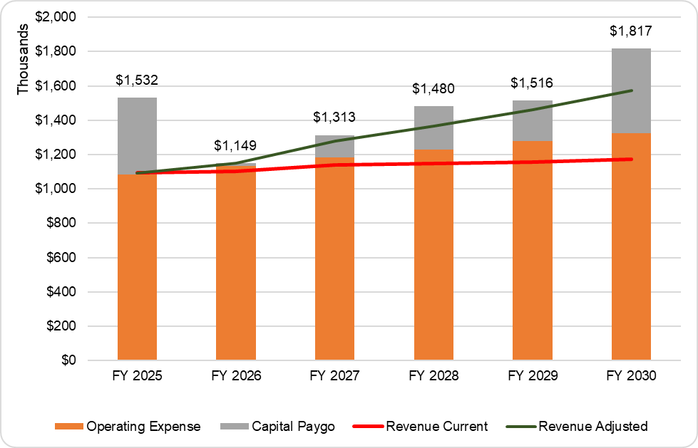
Sewer Financial Plan (Proposed)

Slide 27
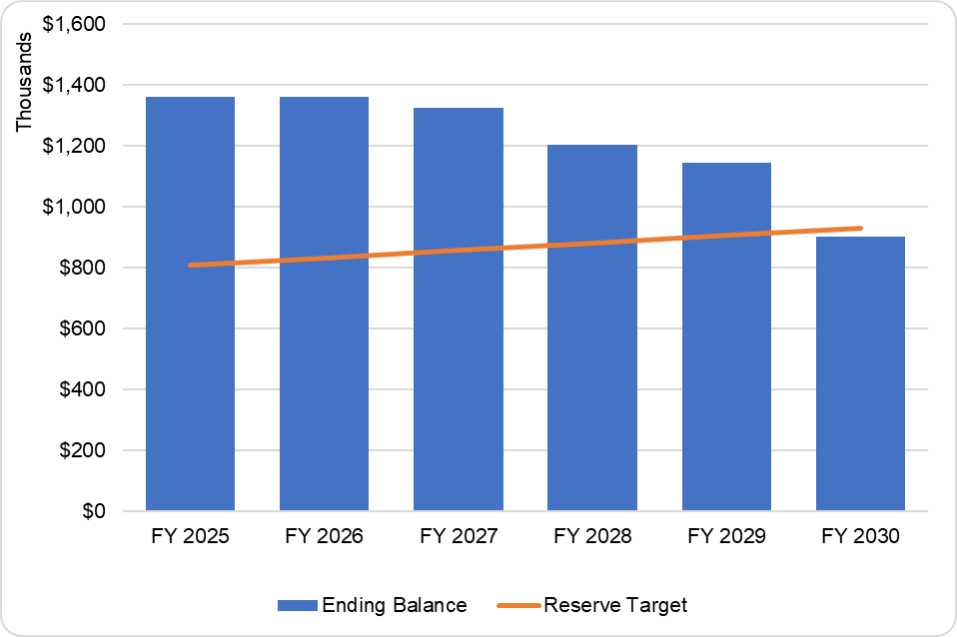
Sewer Fund Balance (Proposed)
Reserve Policy:
Operating Reserve – 3 months operating
Emergency Reserve – 3 months operating
Capital Reserve – Rolling 5-year Average of planned CIP

Slide 28
Sewer Cost of Service/Rate Design

Slide 29
Sewer Cost of Service
Customer Class | Sewer Ratio
Residential | 100%
Automobile Service | 150%
Car Washing Racks | 250%
Automobile Service (restroom) | 75%
Bakeries | 75%
Barbershops | 75%
Bars (per seat) | 5%
Hotels (manager) | 100%
per rental unit no kitchen | 27%
per rental unit with kitchen | 37%
Trailer Park (manager) | 100%
per trailer | 40%
Laundry machine | 150%
Coin Operated Washer | 100%
Professional Offices | 75%
Public Showers | 25%
Retail Stores | 75%
Retail Stores (produce) | 150%
Campground (per space) | 19%
Picnic (per parking) | 2%
Church | 75%
Hospital Bed | 25%
Hospital Kitchen | 75%
Hospital Laundry | 150%
Lodge | 75%
School (per student) | 2%
Category | Cost Allocation
O&M Revenue Requirements | $1,085,173
Non-Operating Revenue Requirements | $446,653
Total | $1,531,826
Other Operating Revenue | ($42,709)
Non-Operating Revenue | ($429,723)
Net Balance Adjustment | ($438,046)
Rate Revenue Requirement | $621,348

Slide 30
Sewer Cost of Service
Customer Class | Sewer Ratio | COS Rate
Residential | 100% | $40.64
Automobile Service | 150% | $60.95
Car Washing Racks | 250% | $101.60
Automobile Service (restroom) | 75% | $30.48
Bakeries | 75% | $30.48
Barbershops | 75% | $30.48
Bars (per seat) | 5% | $2.03
Hotels (manager) | 100% | $40.64
per rental unit no kitchen | 27% | $11.15
per rental unit with kitchen | 37% | $15.17
Trailer Park (manager) | 100% | $40.64
per trailer | 40% | $16.21
Laundry machine | 150% | $60.95
Coin Operated Washer | 100% | $40.64
Professional Offices | 75% | $30.48
Public Showers | 25% | $10.21
Retail Stores | 75% | $30.48
Retail Stores (produce) | 150% | $60.95
Campground (per space) | 19% | $7.78
Picnic (per parking) | 2% | $0.87
Church | 75% | $30.48
Hospital Bed | 25% | $10.16
Hospital Kitchen | 75% | $30.48
Hospital Laundry | 150% | $60.95
Lodge | 75% | $30.48
School (per student) | 2% | $0.80
Customer Class | Billing Units | Base Units
Flat Rate | 770 | 770
Church | - | -
Retail/Office | 46 | 35
Motel Room - Kitchen | 25 | 9
Motel Room - No Kitchen | 1,477 | 406
Restaurant/Bar Seats | 291 | 15
Car Wash | 0 | -
Camping Space | 197 | 38
School-Student | 125 | 2
Total | 2,931 | 1,274
Revenue Requirement |  | Base Units |  | Months |  | Monthly Rate
$621,348 | ÷ | 1,274 | ÷ | 12 | = | $40.64

Slide 31
Proposed Sewer Rates (20% adjustment)
Customer Class | Current Rate | Proposed Rate
Residential | $40.64 | $48.77
Automobile Service | $60.95 | $73.14
Car Washing Racks | $101.60 | $121.92
Automobile Service (restroom) | $30.48 | $36.58
Bakeries | $30.48 | $36.58
Barbershops | $30.48 | $36.58
Bars (per seat) | $2.03 | $2.44
Hotels (manager) | $40.64 | $48.77
per rental unit no kitchen | $11.15 | $13.38
per rental unit with kitchen | $15.17 | $18.20
Trailer Park (manager) | $40.64 | $48.77
per trailer | $16.21 | $19.45
Laundry machine | $60.95 | $73.14
Coin Operated Washer | $40.64 | $48.77
Professional Offices | $30.48 | $36.58
Public Showers | $10.21 | $12.25
Retail Stores | $30.48 | $36.58
Retail Stores (produce) | $60.95 | $73.14
Campground (per space) | $7.78 | $9.34
Picnic (per parking) | $0.87 | $1.04
Church | $30.48 | $36.58
Hospital Bed | $10.16 | $12.19
Hospital Kitchen | $30.48 | $36.58
Hospital Laundry | $60.95 | $73.14
Lodge | $30.48 | $36.58
School (per student) | $0.80 | $0.96
Maintain Current Rate Allocation

Slide 32
Proposed Sewer Rates (5-Years, 10% per year)
Customer Class | FY 2026 | FY 2027 | FY 2028 | FY 2029 | FY 2030
Residential | $44.70 | $49.17 | $54.09 | $59.50 | $65.45
Automobile Service | $67.05 | $73.75 | $81.12 | $89.24 | $98.16
Car Washing Racks | $111.76 | $122.94 | $135.23 | $148.75 | $163.63
Automobile Service (restroom) | $33.53 | $36.88 | $40.57 | $44.63 | $49.09
Bakeries | $33.53 | $36.88 | $40.57 | $44.63 | $49.09
Barbershops | $33.53 | $36.88 | $40.57 | $44.63 | $49.09
Bars (per seat) | $2.23 | $2.46 | $2.70 | $2.97 | $3.27
Hotels (manager) | $44.70 | $49.17 | $54.09 | $59.50 | $65.45
per rental unit no kitchen | $12.27 | $13.49 | $14.84 | $16.32 | $17.96
per rental unit with kitchen | $16.69 | $18.36 | $20.19 | $22.21 | $24.43
Trailer Park (manager) | $44.70 | $49.17 | $54.09 | $59.50 | $65.45
per trailer | $17.83 | $19.61 | $21.58 | $23.73 | $26.11
Laundry machine | $67.05 | $73.75 | $81.12 | $89.24 | $98.16
Coin Operated Washer | $44.70 | $49.17 | $54.09 | $59.50 | $65.45
Professional Offices | $33.53 | $36.88 | $40.57 | $44.63 | $49.09
Public Showers | $11.23 | $12.35 | $13.59 | $14.95 | $16.44
Retail Stores | $33.53 | $36.88 | $40.57 | $44.63 | $49.09
Retail Stores (produce) | $67.05 | $73.75 | $81.12 | $89.24 | $98.16
Campground (per space) | $8.56 | $9.41 | $10.36 | $11.39 | $12.53
Picnic (per parking) | $0.96 | $1.05 | $1.16 | $1.27 | $1.40
Church | $33.53 | $36.88 | $40.57 | $44.63 | $49.09
Hospital Bed | $11.18 | $12.29 | $13.52 | $14.88 | $16.36
Hospital Kitchen | $33.53 | $36.88 | $40.57 | $44.63 | $49.09
Hospital Laundry | $67.05 | $73.75 | $81.12 | $89.24 | $98.16
Lodge | $33.53 | $36.88 | $40.57 | $44.63 | $49.09
School (per student) | $0.88 | $0.97 | $1.06 | $1.17 | $1.29

Slide 33
Next Steps
Approve financial plans and proposed five-year water and sewer rate adjustments
Begin Proposition 218 process
  Set hearing date
  Draft notice
  Mail notice
  Hold hearing
  Adopt rates

Slide 34
Questions?

